Slide 1
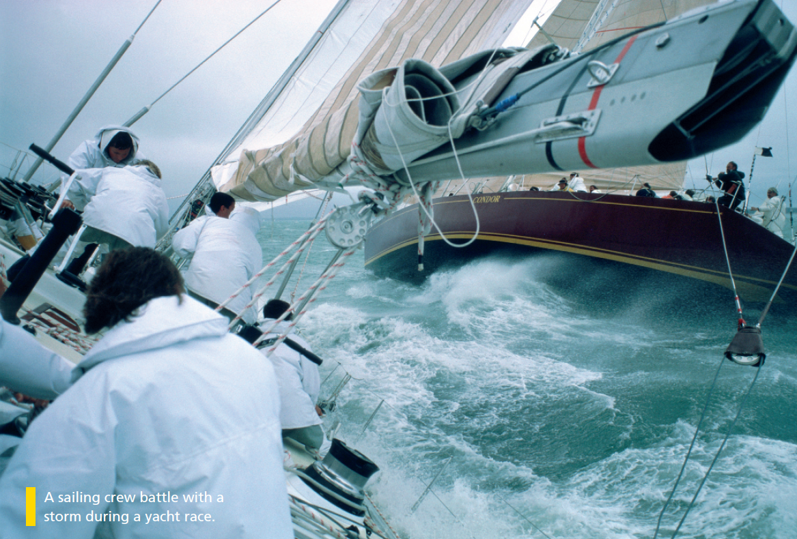

Bringing the world to the classroom and the classroom to life
NGL.CENGAGE.COM/ELT
A PART OF CENGAGE
Notes:
Ask Ss “have you ever travelled on the sea?” → emphasize travelling on the sea will be described as VOYAGE → “are there some dangerous situations people have to battle with on the sea?”
Introduction of the picture.

Slide 2

FEATURES
34 The story behind the photo
When things go wrong in the water
36 Return to Titanic
The truth about a famous underwater discovery
38 Love and death in the sea
An article by marine ecologist Enric Sala
42 Four women and a wild river
A video about a trip down a dangerous river
Unit 3-p. 33

Slide 3
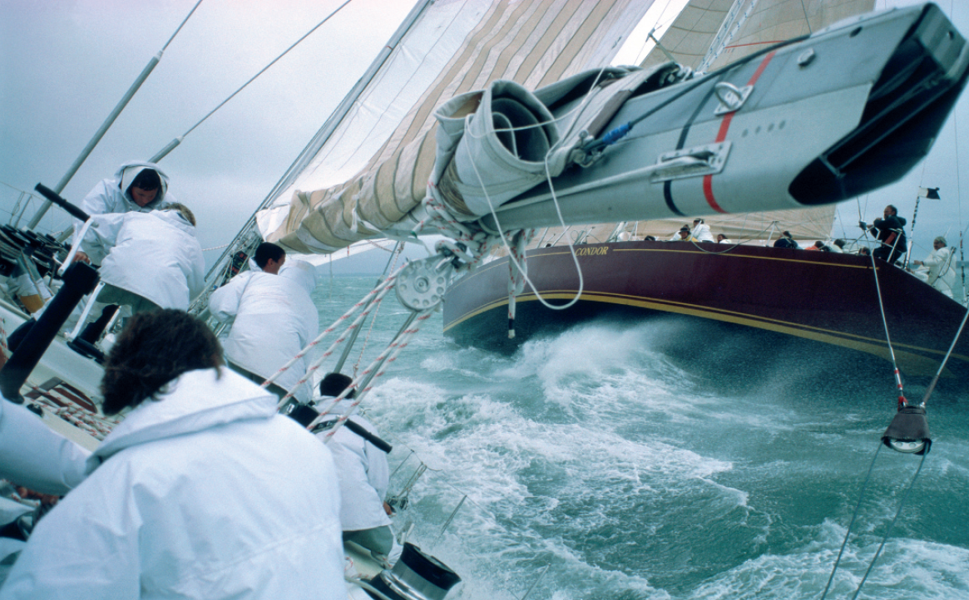
1 Work in pairs. Look at the photo and the caption. Answer the questions.
1 What do you think the people are thinking?
2 Have you ever tried this activity? If not, would you like to?
3 How many words can you think of to describe this experience?
A sailing crew battle with a storm during a yacht race.
EXAMPLE ANSWERS
1 The sailing crew on the yacht in the picture seem to be working hard. They might be thinking: I feel sick, This is fun, This is scary, I want to win the race. They might be thinking about the weather / the sea / getting back to land.
2 Students’ own ideas
3 Possible words: exciting, thrilling; scary, frightening; dangerous, demanding, challenging; tiring, exhausting
Unit 3-p. 33

Slide 4

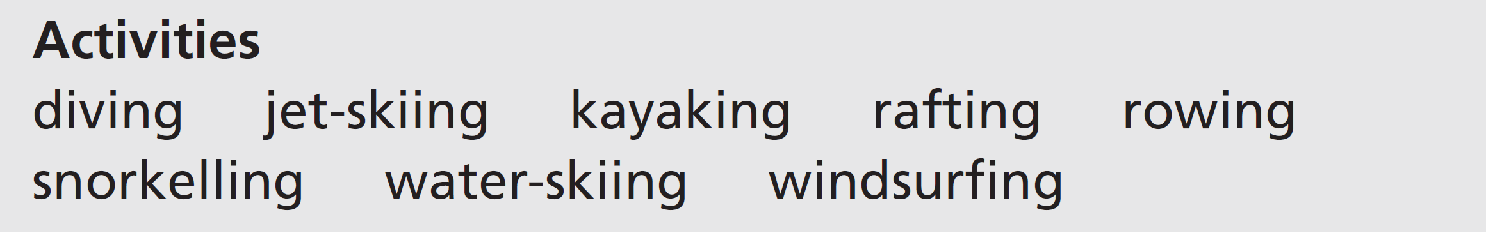
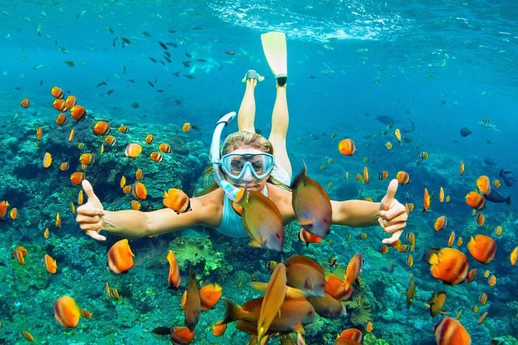
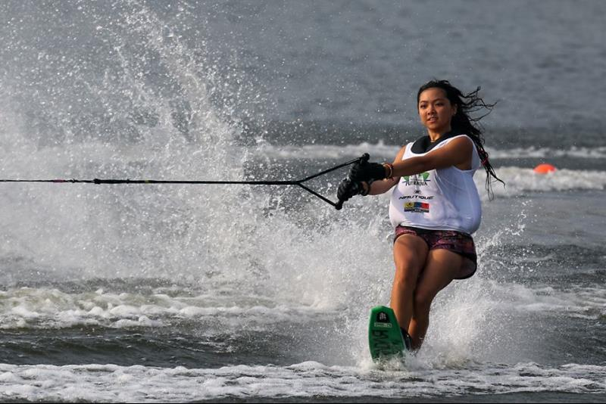
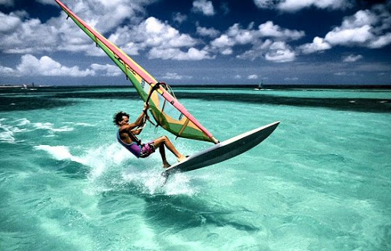
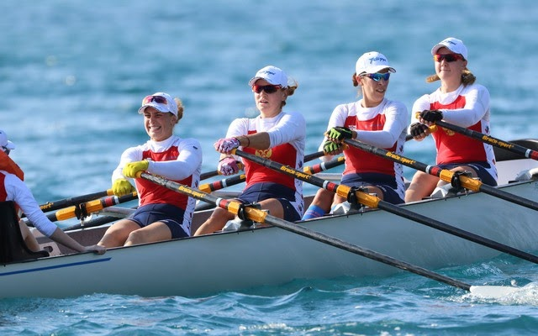
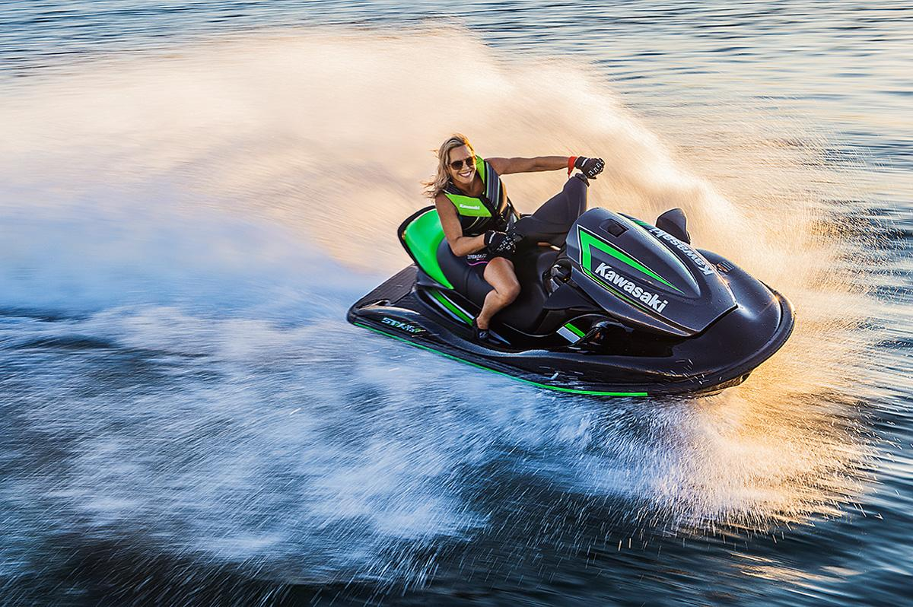
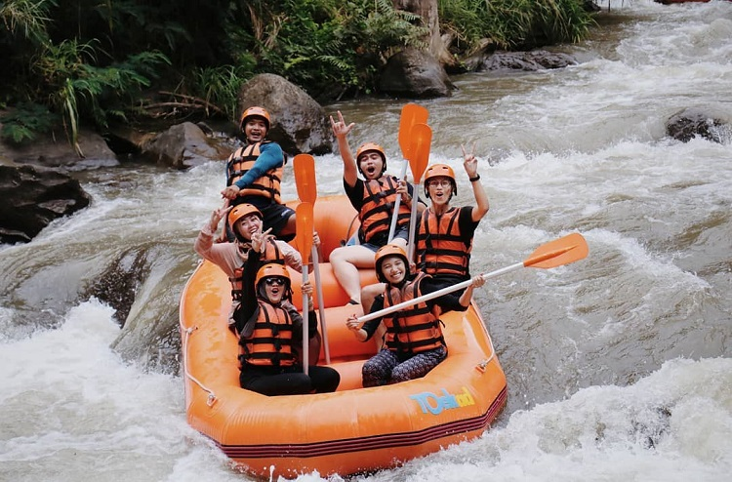
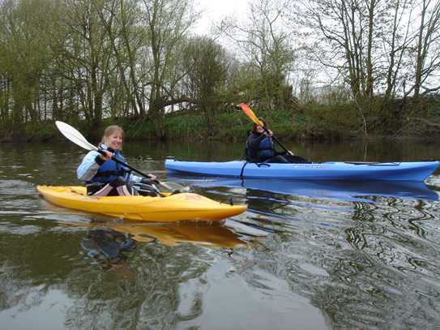
2 Listen to the introduction to a radio programme. Look at the two groups of words. Tick the activities and places you hear.
Track 18
Activities: kayaking, water-skiing, jet-skiing, diving, snorkelling, windsurfing, rafting
Places: ocean, lake, sea, river
Unit 3-p. 33

Slide 5
Script
Track 18
Coming up in today’s programme, we look at some more active alternatives to simply lying around on the beach this summer. Jason reports on a kayaking trip around the beautiful Pacific Ocean coastline of Australia – a more relaxing activity than water-skiing or jet-skiing but just as much fun. Jenna has been to the Red Sea to try diving and snorkelling for the first time, so we’ll find out how she got on. And we also talk to people here in the UK to find out whether windsurfing on a lake is different to windsurfing at the seaside, as well as the best rivers to experience the thrill of real white-water rafting. But first, the latest travel news from Anya.

Slide 6
3 Work in pairs. Where do you think the best place to do the activities in Exercise 2 is?
EXAMPLE ANSWERS
Jet-skiing and windsurfing are usually done on the sea (with some wind if you do windsurfing), diving is usually in the sea, and snorkelling is best done in a shallow, quiet sea where there are a lot of things to see under the water.
Water-skiing can be on the sea, but is perhaps best done on a large lake.
Rowing can be on a lake but is often on a long, wide river.
Kayaking and rafting are popular on fast-flowing rivers, although kayaking can also be done on slower rivers, lakes and on the sea near the coast.
4 Can you think of other sports and leisure activities connected with water? Do you do any of these activities? Where do you do them? Tell your partner.
I go swimming in a lake near here but only in the summer.
EXAMPLE ANSWERS
Other sports and leisure activities connected with water:
swimming, surfing, water polo, sailing, wakeboarding, canoeing, dragon boat racing, kitesurfing, cave diving, fishing
Unit 3-p. 33

Slide 7

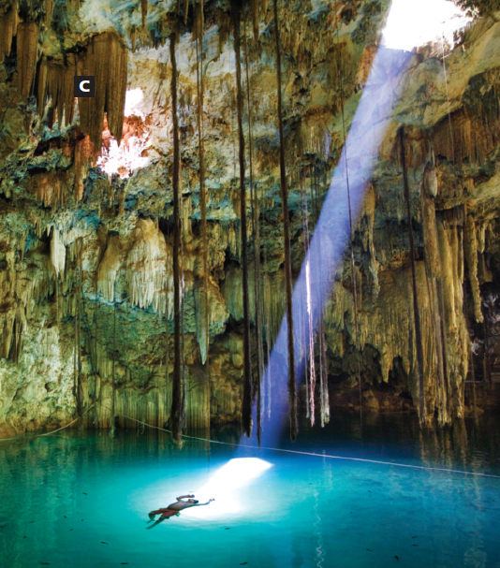
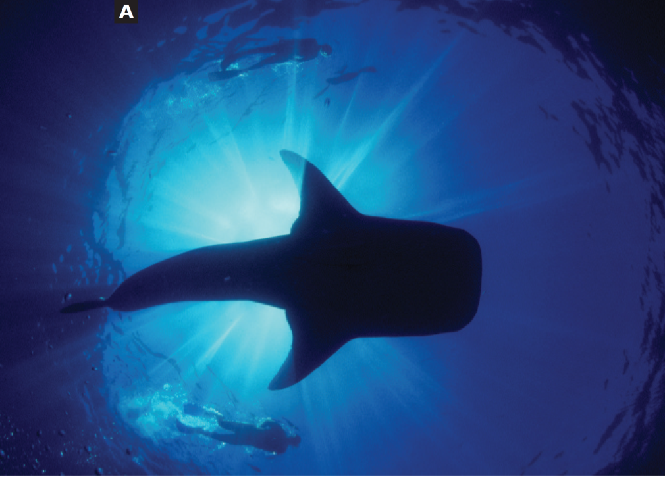
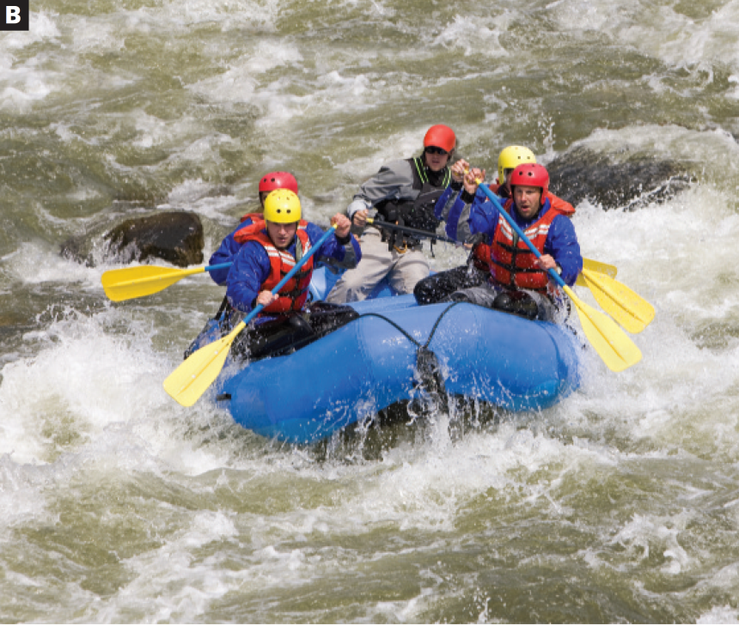
3a The story behind the photo
Listening
1 Look at the photos (A–C). Match the captions (1–3) with the photos.
C
A
B
1 diving in an underground lake in Mexico
2 snorkelling with a whale shark in the Indian Ocean
3 white-water rafting on the Zambezi River
3a-p. 34

Slide 8
2 Listen to the people in two of the photos talking about their photo. Are the sentences true (T) or false (F)?
Track 19
1 The girl was rafting for the first time.
2 The raft was approaching some rapids.
3 She saw a hippo near the river bank.
4 The boy learned to dive because he was bored.
5 He went diving in a dangerous cenote.
6 He wasn’t concentrating on what he was doing.
1 T (On my very first trip, …)
2 F (We were coming down fast from a section of rapids and we could see calm water ahead.)
3 T (Then I saw a big hippo near the river bank.)
4 T (My brother and I were just sitting around on the beach, getting bored, so we took a diving course.)
5 F (we did our first dive in the ‘easy’ cenotes …)
6 F (I was concentrating on doing everything right, …)
3a-p. 34
Notes:
Hippo → hippopotamus (sing.) → hippopotami (plu.)

Slide 9
Script
Track 19
1
I live in Zambia and we have fantastic rivers here. I love rafting on the Zambezi River, it’s one of the best white-water runs in the world. On my very first trip, we had a real surprise! We were coming down fast from a section of rapids and we could see calm water ahead. Then I saw a big hippo near the river bank. It’s best to avoid hippos if you can! We started moving away quickly because it was coming towards us! And then, we were going around a small island in the middle of the river, when suddenly …
2
I began diving when I was about twelve. I actually learned to dive while I was on holiday in Mexico. My parents went there to explore the underground lakes – or cenotes, as they’re called here. My brother and I were just sitting around on the beach, getting bored, so we took a diving course. Then we did our first dive in the ‘easy’ cenotes while my parents were exploring the dangerous stuff. It wasn’t very deep underground and the sun was shining in through an opening in the roof of the cave. It was really calm and beautiful. I felt like staying there all day! I was concentrating on doing everything right. I didn’t notice that …

Slide 10
3 What do you think happened next? Choose one of the options (a–c). Then listen to the whole story and check your ideas.
Track 20
1 a The hippo came after them and attacked the raft.
b A crocodile jumped into the river close to the raft.
c The raft sank and they all swam to the river bank.
2 a His air ran out and he had to go to the surface.
b His mother saw a sea snake just behind him.
c He almost got lost in the underground tunnels.
4 Pronunciation d and t after -ed endings
a Listen to this sentence from the second story. Notice how the speaker links the -ed verb ending to the t at the start of the next word. Do you hear one sound or two?
Track 21
I actually learned to dive while I was on holiday in Mexico.
b Listen and repeat the sentences you hear.
Track 22
3a-p. 34

Slide 11
Script
Track 20
1 I live in Zambia and we have fantastic rivers here. I love rafting on the Zambezi River, it’s one of the best white-water runs in the world. On my very first trip, we had a real surprise! We were coming down fast from a section of rapids and we could see calm water ahead. Then I saw a big hippo near the river bank. It’s best to avoid hippos if you can! We started moving away quickly because it was coming towards us! And then, we were going around a small island in the middle of the river, when suddenly we surprised an eight-metre crocodile. It was lying in the sun on the other bank. It jumped into the water about a metre away from our boat – it nearly landed in the boat! Fortunately, it didn’t take much interest in us so we got away! Maybe it wasn’t hungry!
2 I began diving when I was about twelve. I actually learned to dive while I was on holiday in Mexico. My parents went there to explore the underground lakes – or cenotes, as they’re called here. My brother and I were just sitting around on the beach, getting bored, so we took a diving course. Then we did our first dive in the ‘easy’ cenotes while my parents were exploring the dangerous stuff. It wasn’t very deep underground and the sun was shining in through an opening in the roof of the cave. It was really calm and beautiful. I felt like staying there all day! I was concentrating on doing everything right. I didn’t notice that that I was swimming into an area that was only for advanced divers. There were ropes and signs to stop you going into some tunnels where it was easy to get lost. Luckily for me, my mum realized pretty quickly that I was missing and she came after me. I still had no idea where I was going!

Slide 12
Script
Track 22
1 They tried to get away.
2 We rowed down the river.
3 What happened to you?
4 The crocodile looked dangerous to me.
5 We arrived too late.
6 We walked ten kilometres along the beach yesterday.

Slide 13
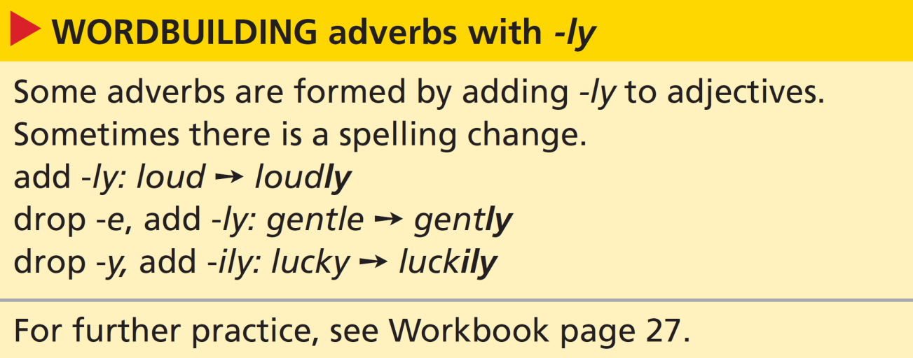
Vocabulary describing experiences
3a-p. 34

Slide 14
5 Look at the wordbuilding box. Underline the adverb in these sentences. What is the adjective from which the adverb is formed?
1 The hippo suddenly saw us.
2 We reached the river bank safely.
3 I found the way out of the cave easily.
4 The crocodile jumped noisily into the water.
5 Fortunately, nobody was hurt in the accident.
6 I got into the pool very carefully.
7 I cut my feet badly on the rocks.
8 I got on the surfboard and immediately fell off.
1 suddenly (from the adjective sudden)
2 safely (from the adjective safe)
3 easily (from the adjective easy)
4 noisily (from the adjective noisy)
5 Fortunately (from the adjective fortunate)
6 carefully (from the adjective careful)
7 badly (from the adjective bad)
8 immediately (from the adjective immediate)
3a-p. 34

Slide 15
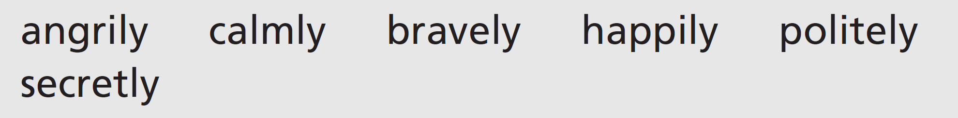
6 Work in pairs. Think of at least two activities you can do in the manner of each adverb.
EXAMPLE ANSWERS
angrily: shout, argue, walk out of a room
calmly: speak to someone, look after a baby, carry on working
bravely: fight, argue, suffer pain
happily: open your presents, sing in the bath
politely: apologize, ask for information, say no
secretly: make a promise, go away, ask someone to marry you
3a-p. 35

Slide 16
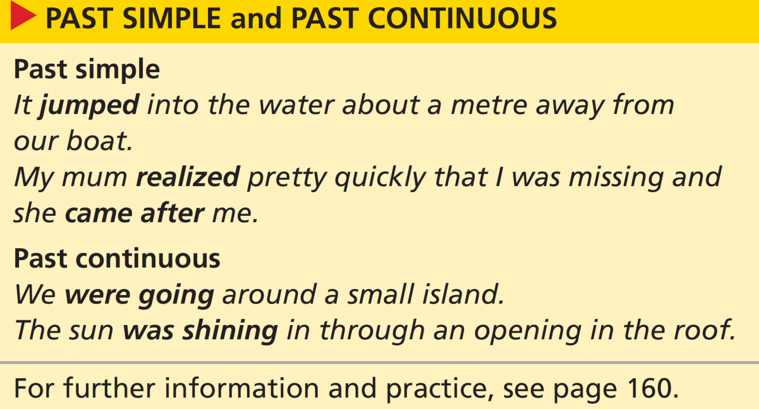

Grammar past simple and past continuous
7 Look at the grammar box. Which verb form do we use to talk about these things?
past continuous
1 an unfinished and continuing activity or background situation
2 a short completed action or a sequence of actions
past simple
3a-p. 35

Slide 17
8 Underline the key event in these questions (1−2) about the rafting story in Exercise 1. Then match the questions with the answers (a–b).
b
1 What were they doing when they saw the hippo?
2 What did they do when they saw the hippo?
a
a They tried to get away.
b They were coming down the river.
9 Choose the correct option to complete the rules.
1 We often ask questions in the past simple / past continuous about activities at the time of the key event.
2 We often ask questions in the past simple / past continuous about actions after the key event.
3a-p. 35

Slide 18
10 Complete the text about photo A with the past simple and past continuous forms of the verbs.
While I 1 ________________ (work) in the Maldives, I 2 _______________ (hear) that there were whale sharks in the area. That’s why I
3 _______________ (begin) snorkelling – whale sharks are the world’s biggest fish and they aren’t dangerous! I 4 _______________ (buy) a snorkel and 5 _______________ (set out) with some friends on a boat. Almost immediately, a whale shark 6 _______________ (swim) past the boat. It
7 _______________ (move) really quickly, but we 8 _______________ (manage) to catch up with it. We all 9 _______________ (get) into the water and 10 _______________ (spend) about two minutes with the shark. Afterwards, I 11 _______________ (feel) absolutely wonderful!
was working
heard
began
bought
set out
swam
was moving
managed
got
spent
felt
3a-p. 35

Slide 19
11 Write sentences with the past simple and past continuous forms of the verbs. Use because, when, while and so.
1 I / take / a photo / I / drop / my camera.
2 They / not hear / you / they / not listen.
3 I / have / problems / my teacher / help me.
4 We / see / bears / we / hike.
5 He / not look / at the road / he almost / have / an accident.
6 I / fall over / I / run / for the bus.
1 I was taking a photo when I dropped my camera.
2 They didn’t hear you because they weren’t listening.
3 I had problems, so my teacher helped me.
4 We saw some bears while we were hiking.
5 He wasn’t looking at the road, so he almost had an accident.
6 I fell over while I was running for the bus.
3a-p. 35

Slide 20
12 Work in pairs. Ask and answer questions about the other sentences with both the past simple and the past continuous forms of the verbs.
1 I lost my wallet.
When did you realize?
Were you shopping at the time?
2 I met an old friend in the street.
3 A car ran into me.
4 A friend of mine got some good news.
5 My neighbour saw a robbery.
EXAMPLE ANSWERS
2 Where did you meet her?
What was she doing?
What did you say?
Where was she going?
When did you last see her?
4 What was their news?
What did he say?
How did you react?
5 What did she see?
What was she doing at the time?
How did she react?
Did she ring the police?
3 Were you hurt?
What did you do?
How did it happen?
Where were you going at the time?
3a-p. 35

Slide 22

Speaking
13 Work in pairs.
Student A: Think about an interesting thing that happened the first time you tried something new. Answer your partner’s questions.
Student B: Ask ten questions and decide if your partner had a good or bad experience.
What were you trying to do?
Did you have any special equipment?
EXAMPLE ANSWERS
Here are some possible questions:
When did you first try this skill?
Where were you?
What happened?
How did you feel while you were doing it?
How did you feel after?
How good at it are you now?
Do you want to do it again?
3a-p. 35

Slide 23
MY LOVE WILL GO ON
Every night in my dreams
I see you, l feel you
That is how l know you go on
Far across the distance
And spaces between us
You have come to show you go on
Near, far, wherever you are
I believe that the heart does go on
Onec more you open the door
And you're here in my heart
And my heart will go on and on
Love can touch us one time
And last for a lifetime
And never let go till we're gone

Slide 24
Love was when l loved you
One true time l hold to
In my life we'll always go on
Near, far, where you one
I believe that the heart does go on
Once more you open the door
And you're here in my heart
And my heart will go on and on
You're here, here there's nothing l fear
And l know that my heart will go on
We'll stay forever this way
You are safe in my heart
And my heart will go on and on

Slide 25
3b Return to Titanic
Reading
1 Read the interview with the man who discovered the wreck of Titanic. Match three of the questions (a–e) with the paragraphs (1–3). Then listen and check your answers.
Track 23
a Did you know you were looking at Titanic when you saw the first pieces of debris?
b How did you discover Titanic?
c How long did it take to locate Titanic?
d Tell me about the experience of seeing Titanic again in 2004.
e When did you find out about how Titanic sank?
1 e
2 a
3 d
3b-p. 36

Slide 26
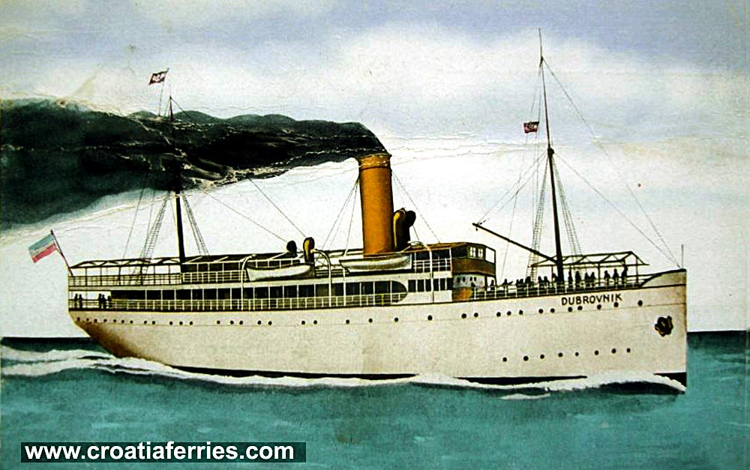
VOCABULARY
steamship /ˈstiːm.ʃɪp/

Slide 27
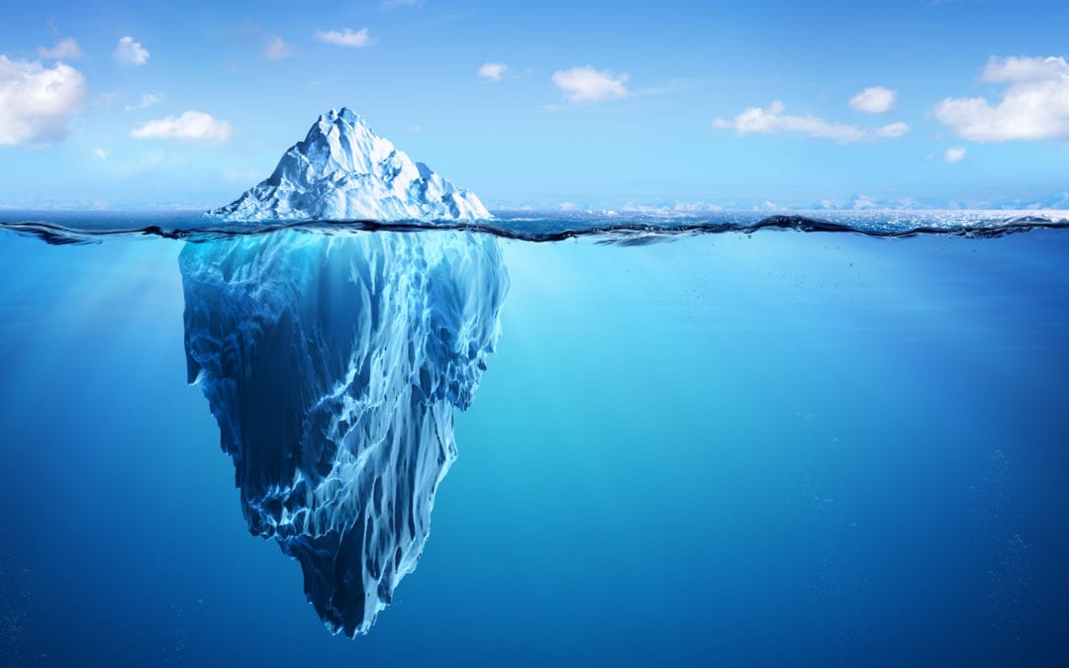
iceberg /ˈaɪs.bɜːɡ/

Slide 28
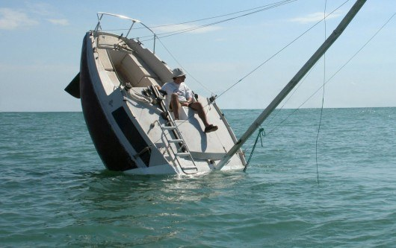
sink /sɪŋk/

Slide 29
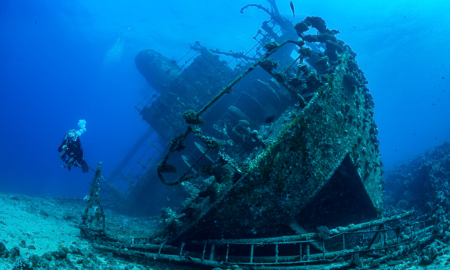
wreck (n) /rek/

Slide 30
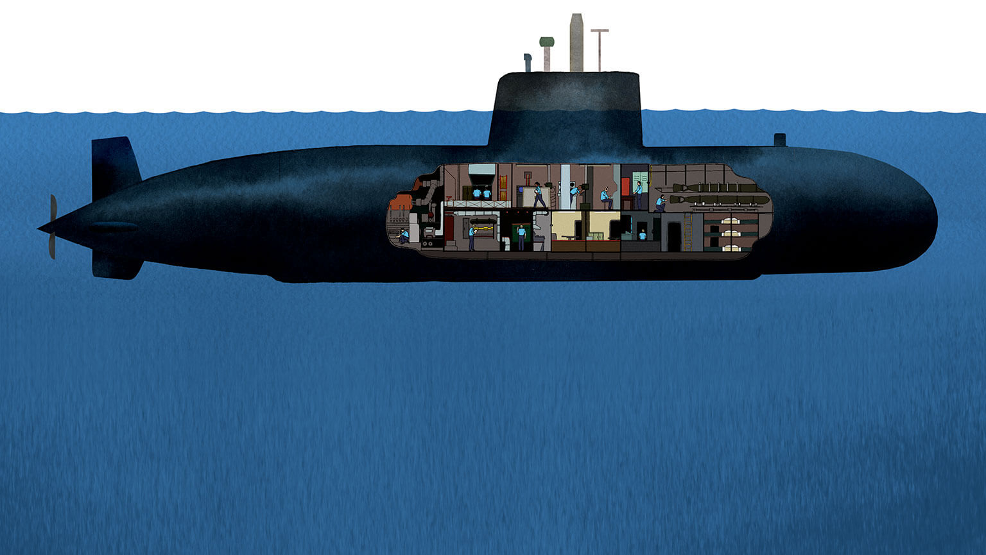
submarine (n) /ˌsʌb.məˈriːn/

Slide 31

Track 23
On 15 April 1912, the largest passenger steamship ever built hit an iceberg and sank in the North Atlantic Ocean. Titanic had left Southampton, England, five days earlier and was on her first voyage.
In 1985, the explorer Dr Robert Ballard found the wreck of Titanic. He went back to Titanic nineteen years later to see how it had changed.
It was during the Cold War. I was on a secret mission when we found Titanic. The US Navy had agreed to pay for our new underwater video technology. In return, we had agreed to use the technology to look for two submarines which had disappeared in the 1960s.
Not at first, because many ships had sunk in that area. When we realized it was Titanic, we jumped for joy. Then we realized we were celebrating something where people had died.
I saw champagne bottles with the corks still in. The box holding the bottles had disappeared long ago. Suddenly, I noticed a woman’s shoe. Nearby, I saw a pair of smaller shoes – perhaps they’d belonged to a child. I felt that the people who had died here in 1912 were speaking to me again. But I knew that other people had been there since my first visit. Hollywood filmmaker James Cameron had been there. A New York couple had even got married. I was disappointed. It was exactly what I didn’t want to happen. I’d asked people to treat Titanic’s remains with respect. The story of Titanic is not about the ship, it’s about the people.
See the whole story on the National Geographic Channel. Titanic: The Final Secret
3a-p. 36

Slide 32
Track 23
On 15 April 1912, the largest passenger steamship ever built hit an iceberg and sank in the North Atlantic Ocean. Titanic had left Southampton, England, five days earlier and was on her first voyage.
In 1985, the explorer Dr Robert Ballard found the wreck of Titanic. He went back to Titanic nineteen years later to see how it had changed.
When did you find out about how Titanic sank?
It was during the Cold War. I was on a secret mission when we found Titanic. The US Navy had agreed to pay for our new underwater video technology. In return, we had agreed to use the technology to look for two submarines which had disappeared in the 1960s.
Did you know you were looking at Titanic when you saw the first pieces of debris?
Not at first, because many ships had sunk in that area. When we realized it was Titanic, we jumped for joy. Then we realized we were celebrating something where people had died.
Tell me about the experience of seeing Titanic again in 2004.
I saw champagne bottles with the corks still in. The box holding the bottles had disappeared long ago. Suddenly, I noticed a woman’s shoe. Nearby, I saw a pair of smaller shoes – perhaps they’d belonged to a child. I felt that the people who had died here in 1912 were speaking to me again. But I knew that other people had been there since my first visit. Hollywood filmmaker James Cameron had been there. A New York couple had even got married. I was disappointed. It was exactly what I didn’t want to happen. I’d asked people to treat Titanic’s remains with respect. The story of Titanic is not about the ship, it’s about the people.
3a-p. 36

Slide 33
2 Read the interview again. Answer the questions.
1 What was the secret mission that Ballard was involved with?
2 How did Ballard and his team feel when they found Titanic?
3 How did Ballard feel when he returned to the wreck in 2004? Why?
1 He was on a secret mission to look for two missing US submarines that had disappeared in the 1960s.
2 They ‘jumped for joy’ at first, then realized that they shouldn’t be celebrating something where people had died.
3 He felt disappointed because he’d asked people to treat Titanic’s remains with respect and he felt this hadn’t happened.
3 Work in pairs. Do you think the remains of Titanic should be left on the seabed? Or should they be removed and put in a museum? Tell your partner.
3b-p. 36

Slide 34
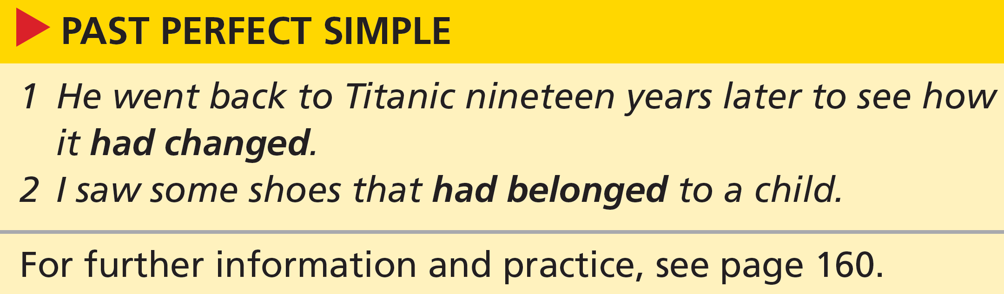
5 Look at the grammar box. Underline what happened first. Then choose the correct option to complete the sentence.
We use the past perfect simple to show that an event took place before / after another event in the past.
1 He went back to Titanic nineteen years later to see how it had changed.
2 I saw some shoes that had belonged to a child.
3b-p. 37

Slide 35
6 Choose the correct option to complete the sentences.
1 When Titanic hit the iceberg, it was / had been at sea for five days.
2 When Titanic hit the iceberg, it sank / had sunk.
3 By the time they sounded the ship’s alarm, it was / had been too late.
4 By the time a rescue boat came, many people died / had died.
5 When Ballard used video technology, he found / had found the wreck.
6 By the time Ballard returned to the site, several people visited / had visited it.
1 had been (at sea before it hit the iceberg)
2 sank (sank after it hit the iceberg)
3 was (by the time = used to mean that something has already happened at the time something else happens. Here, they; ‘sounded the alarm’ but ‘it was already too late’ – it was too late before the alarm was sounded)
4 had died (died before the boat came)
5 found (used technology then found the wreck)
6 had visited (people visited before Ballard returned)
3b-p. 37

Slide 36
7 Use the past perfect simple to answer the questions with your own ideas. Then work in pairs and compare your answers.
1 Why did Titanic collide with an iceberg?
2 Why did so many people die when the ship sank?
3 Why was Ballard upset in 2004?
4 Why do you think a couple got married at the wreck site?
5 Why do you think James Cameron visited the wreck?
EXAMPLE ANSWERS
1 The ship hadn’t seen the iceberg in time. / They didn’t have the advance warning systems that modern ships have.
2 They hadn’t put enough lifeboats on the ship.
3 People hadn’t treated Titanic’s remains with respect.
4 They had decided it was a romantic place.
5 He had decided to make a film about the disaster.
3b-p. 37

Slide 37
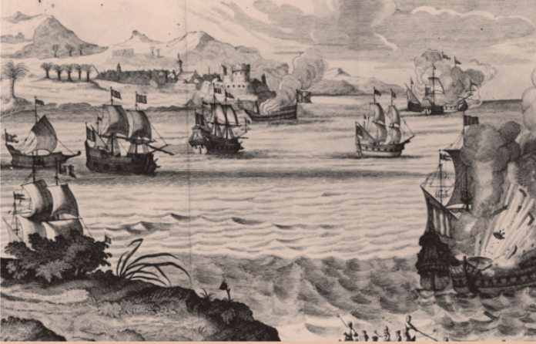
8 Complete the text with the past simple and past perfect simple forms of the verbs.
Captain Henry Morgan 1 _______________ (be) one of the most famous pirates of the seventeenth century. In 2010, archaeologists
2 _______________ (begin) to lift cannons from a ship they
3 _______________ (discover) two years earlier, near the coast of Panama. The archaeologists 4 _______________ (feel) confident that the ship was Morgan’s main ship, Satisfaction. This ship and several others
5 _______________ (sink) in 1671 when they 6 _______________ (hit) rocks. Three years later, after Morgan 7 _______________ (become) extremely rich from pirate attacks, he 8_______________ (retire) from pirate activities to become the governor of Jamaica.
was
began
had discovered
felt
had sunk
hit
had become
retired
3b-p. 37

Slide 38
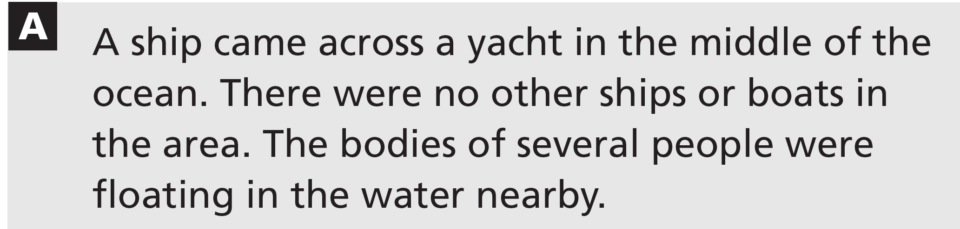
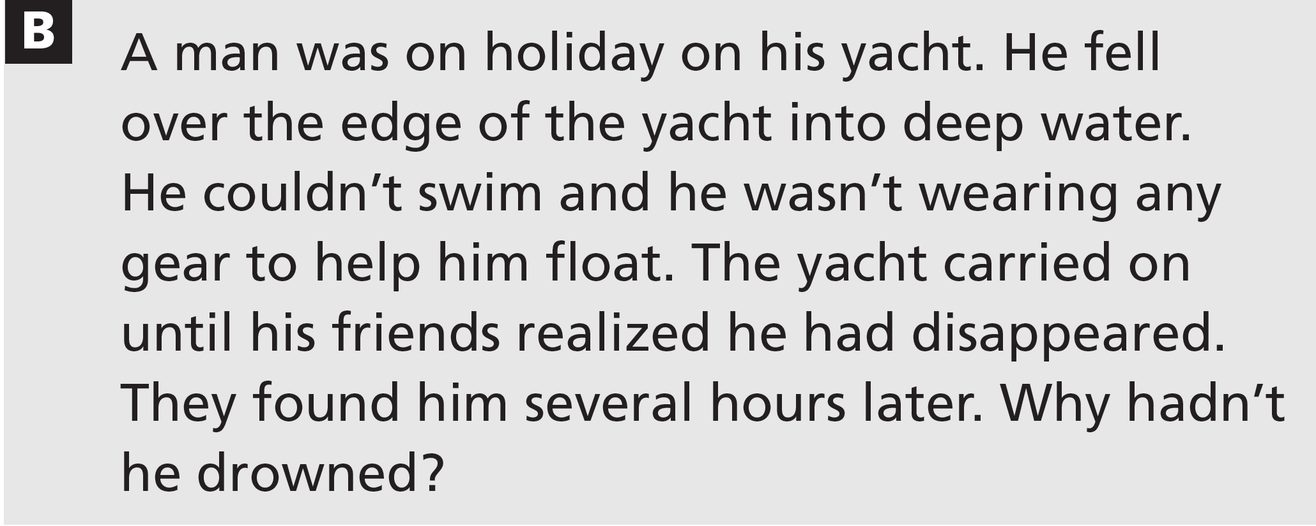
Speaking
9 Work in two pairs within a group of four. Read these puzzles. Then follow the instructions.
Pair A: Turn to page 153 and follow the instructions.
Pair B: Turn to page 154 and follow the instructions.
Ask the students to refer to the Communication activities at the back of the Student’s Book for the solutions. Pair A should go to page 153 and pair B to page 154.
3b-p. 37

Slide 39
10 Work in pairs. Complete this sentence in as many ways as you can. Use the past perfect simple. Take turns to begin another sentence with By the time.
By the time this lesson started , ...
3b-p. 37

Slide 40
3c Love and death in the sea
Reading
EXAMPLE ANSWERS
1 Work in pairs. Discuss the questions.
1 Where’s the best place to go swimming? A pool, a lake, the sea, … ?
2 What kind of problems can swimmers have in each place?
1 & 2 Students’ own ideas. Here are some arguments for and against, and some problems:
A (natural) pool or a lake:
(+) still and calm, easy to swim, often an attractive location, can do water sports on a big lake
(–) cold, perhaps very deep, could be plants and fish, could be bad for your health if you swallow the water
A (man-made swimming) pool:
(+) safe, not too deep, good changing and drying facilities, not too cold, lanes
(–) busy, boring, have to pay to go in, restrictions on diving and activities you can do, not always open, chlorine in the water hurts your eyes The sea:
(+) fun, challenging, salt helps you float, can do lots of games and activities and water sports, can splash and paddle as well as swim
(–) dangerous, difficult to swim, can be polluted, fish and seaweed can be a problem, often cold, salt hurts your eyes and makes you feel ill if you swallow it
3c-p. 38

Slide 41
2 Enric Sala is a marine ecologist. Read the article he wrote for World Ocean Day. Answer the questions.
1 What happened to Enric Sala?
2 Why did this happen to him?
3 How has the experience changed him?
1 He tried to swim out to sea during a storm, realized it was too difficult, so he tried to swim back but found he couldn’t reach the beach. (paragraph 2)
2 He didn’t respect the sea – it was a moment of Catalan bravado to go into the sea when it was too stormy. (paragraph 2)
3 He has learnt his lesson, feels lucky to be alive, and respects the sea now. He does not go swimming when it is dangerous. (last paragraph)
3c-p. 38

Slide 42
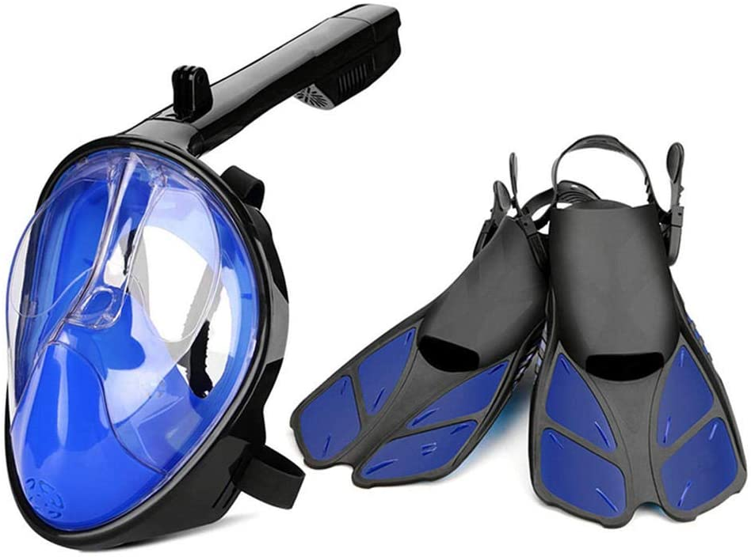
VOCABULARY
mask and fins

Slide 43

Track 24
The sea has almost killed me a couple of times. It wasn’t her fault; it was mine, for not respecting her. I still remember the last time, a stormy day off the Costa Brava of Spain, in early summer 2008. Every time I think about it, my heart races.
The place where I used to swim every day was hit by a storm with strong eastern winds. The clear blue waters of summer quickly changed into a dirty soup of sand and cold grey water. Waves were breaking in all directions. But beyond the surf zone, the sea seemed swimmable. In a moment of Catalan bravado, I put on my swimming suit, mask and fins, and got into the water. It was crazy, but I did it. I swallowed sand and salt while I was trying to swim through the surf zone. Fighting against the water, I swam – I still don’t know why – for twenty minutes. The storm got worse and I decided to call it a day. I turned to swim back. Then I realized I couldn’t get to the beach.
3c-p. 39

Slide 44
Track 24
Waves were breaking all around me. I tried to bodysurf one wave to the shore, but it took me down under the water. When I came up, I turned around and a second wave hit me just as hard, taking me down again. I hit the sandy bottom. I pushed myself up, but once again, waves were coming and I couldn’t rest or breathe. I was caught in the surf zone, with waves pushing me out and a current pulling me in. I wasn’t getting any closer to the beach.
The sea is our mother, sister and home, and as such I love her. We get so much from the sea. She gives us life, oxygen and food. Without the ocean and all the life in it, our planet would be much poorer. We should thank the sea, the ocean, every day. But on this day, I was having a hard time feeling grateful.
After a few more attempts, I decided to let myself go and give up the fight. I took a deep breath. The next wave took me down and forward. I hit the bottom with my back. I rolled over, hit my head, and after what seemed the longest minute of my life, I found myself lying in a foot of water. I crawled out of the water and onto the beach. I’d got out, but I’d lost my mask, snorkel and one fin. My whole body was sore. I sat on the beach watching the sea and feeling lucky to be alive. I walked back home slowly, like a beaten dog.
3c-p. 39

Slide 45
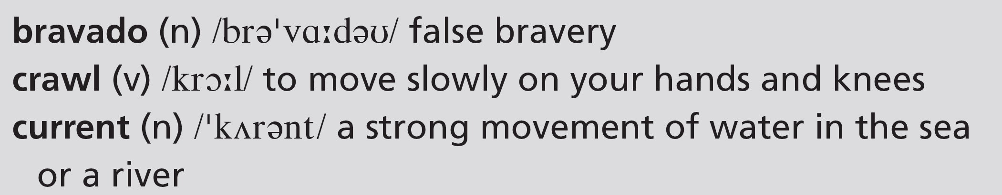
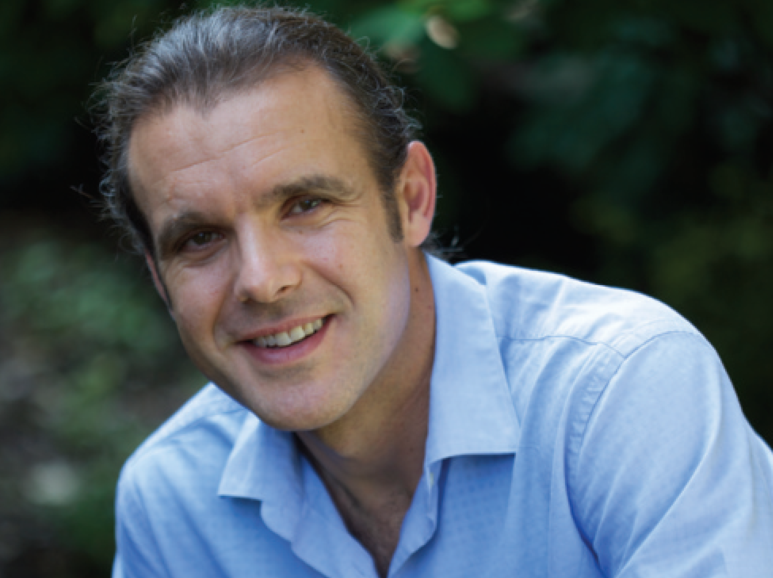
Track 24
Some days the sea wants us and some days she doesn’t. Since that day, I have not been to the sea when she does not want me. I have learned my lesson. I now thank the sea every day the surface is calm, the waters are clear and diving is easy.
3c-p. 39

Slide 46
3 Find the expressions in the article. What do they mean? Choose the correct option.
1 a couple of times
on several / two occasions
2 my heart races
I feel afraid / angry
3 I decided to call it a day
I decided to stop / try again tomorrow
4 I was having a hard time
it was difficult for me / it took a long time
5 I decided to let myself go
I decided to stop swimming / try again
6 I have learned my lesson
my bad / good experience taught me something
2 afraid (my heart goes very fast because of fear – also, in other contexts, from excitement or pressure)
3c-p. 38

Slide 47
4 Discuss the questions with your partner.
1 Sala talks about three decisions he took. What were the decisions and what were the consequences of each one?
2 Sala describes how he feels about the sea. Do you think what he says is unusual? Why? / Why not?
3 Do you think the title of the article is a good one? Why? / Why not?
1 The first decision was to go swimming despite the storm. The consequence was that he had to fight against the sea and swallowed lots of seawater and sand.
The second decision was to turn back. The consequence was that he was hit by waves and caught in the surf zone, and he couldn’t get back.
The third decision was to give up fighting against the sea. Fortunately, the consequence was that he was carried to the shore and survived.
2 He speaks about the sea as if it were a person. The feelings he expresses are very intense and romantic.
3 Students’ own opinions
3c-p. 38

Slide 48
Critical thinking drawing conclusions
5 We can sometimes draw conclusions from a piece of writing even if the author does not state these things specifically. Read the sentences and say which three things are conclusions and which one is stated in the text.
1 The Costa Brava is a dangerous place for swimmers.
2 Enric Sala has recovered from the experience now.
3 He was lucky to be alive after the experience.
4 The experience has made him wiser.
conclusion
conclusion
3 stated in the text (I sat on the beach watching the sea and feeling lucky to be alive.)
conclusion
6 Work in pairs. Do you agree with the conclusions in Exercise 5? Give reasons for your answers.
EXAMPLE ANSWERS
1 Yes – because the weather can make it dangerous to swim there.
2 Yes – because he has recovered enough to tell the story and goes swimming again when the weather is OK / the sea is calm / ‘the sea wants me’.
No – because he says his heart still races when he thinks about it.
4 Yes – because he used to go swimming every day, but now he knows he should only go when the conditions are right.
3c-p. 38

Slide 49
Word focus get
7 Look at the verbs in bold in these sentences. Find expressions with get in the article which have the same meanings as the verbs. Then rewrite the sentences with get.
1 I entered the pool.
2 The weather didn’t improve.
3 I couldn’t reach the shore.
4 I wasn’t moving towards the land.
5 We receive so much from nature.
6 We put the bird in a cage, but it escaped.
I got into the pool.
The weather got worse.
I couldn’t get to the shore.
I wasn’t getting any closer to the land.
We get so much from nature.
We put the bird in a cage but it got out.
3c-p. 38

Slide 50
8 Write six more sentences with the expressions with get from the article. Write about your own experiences.
EXAMPLE ANSWERS
I got into my car this morning and drove to school.
My English has got worse!
I get a lot of support from friends.
I got out of doing the washing up this morning.
3c-p. 38

Slide 51
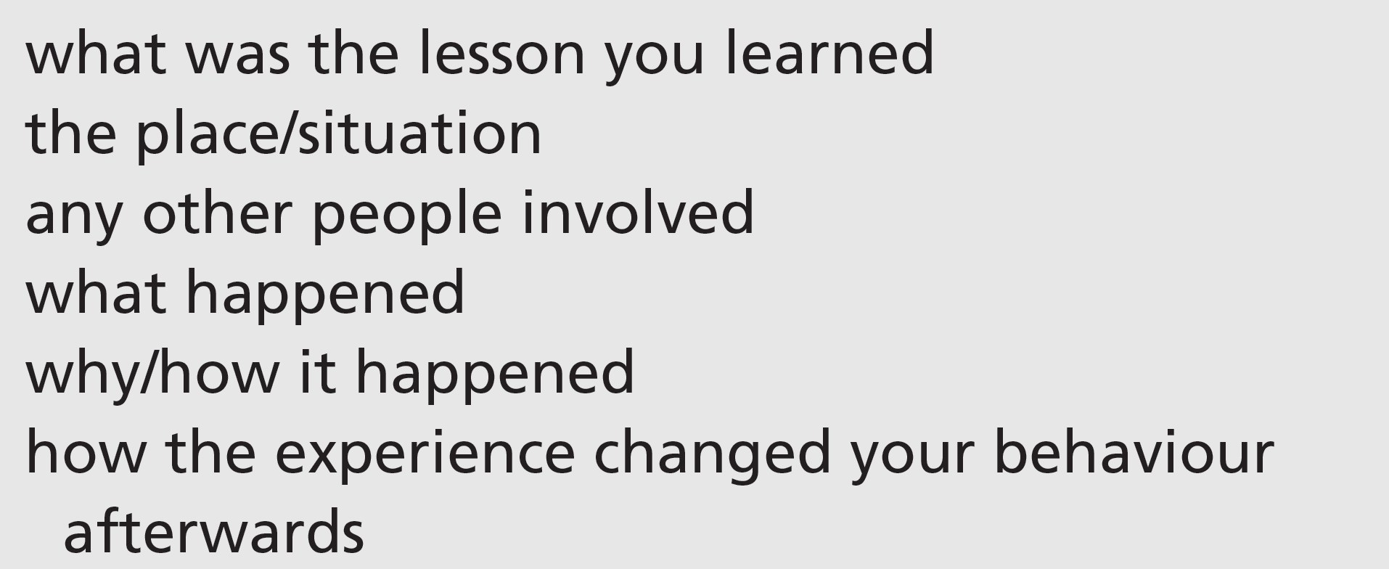
Speaking
9 Think about an experience you had where you ‘learned a lesson’. Use these ideas to think about the details.
10 Work in small groups. Tell each other about your experiences. Has anyone else had a similar experience?
A: I almost had an accident once when I was driving and I was really too tired.
B: Where were you going?
3c-p. 38

Slide 52
3d No way!
Real life telling stories
1 Work in groups. Which of these statements (a–d) are true for you? Tell your group.
a When I’m in a group, I listen more than I talk.
b I’m always telling funny stories about things that happen to me.
c I’m no good at telling stories, but I’m a good listener.
d People say I exaggerate, but they always laugh at my stories.
Students’ own ideas
3d-p. 40

Slide 53
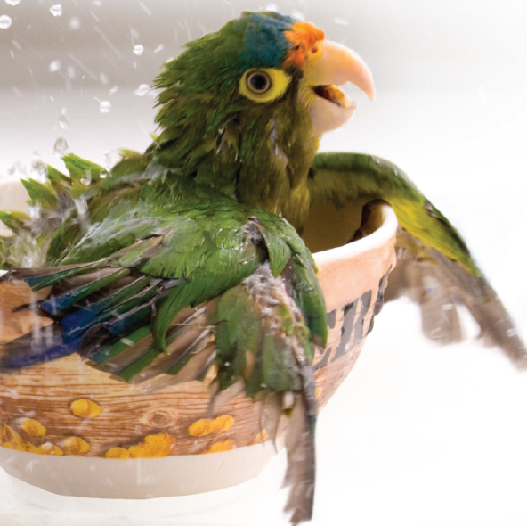
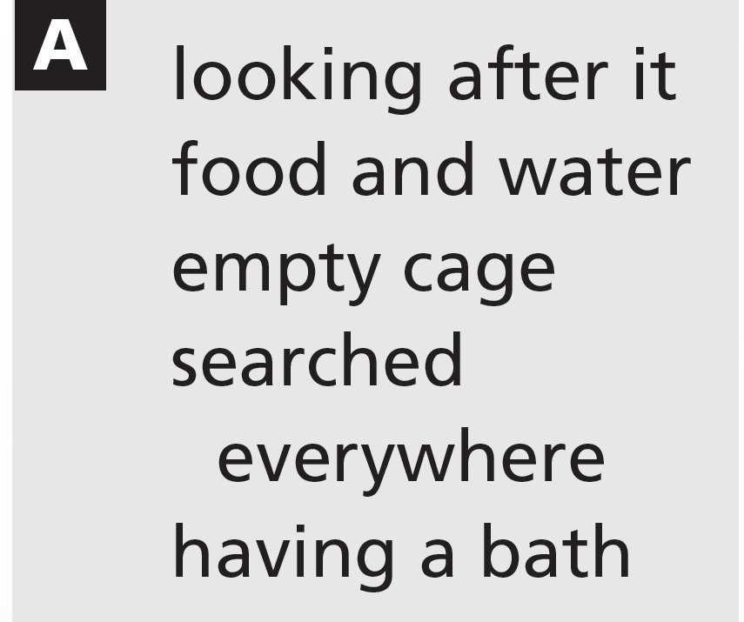
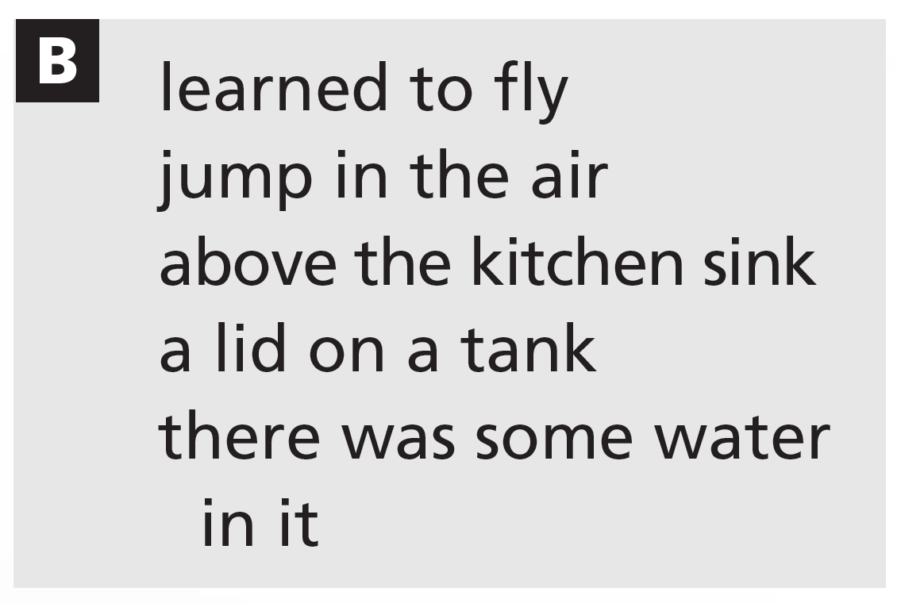
2 Look at the photo. Which group of words (A or B) do you think are from the story of the photo? Then work in pairs. Compare your ideas and explain your reasons.
A is more likely (empty cage; having a bath).
3d-p. 40

Slide 54
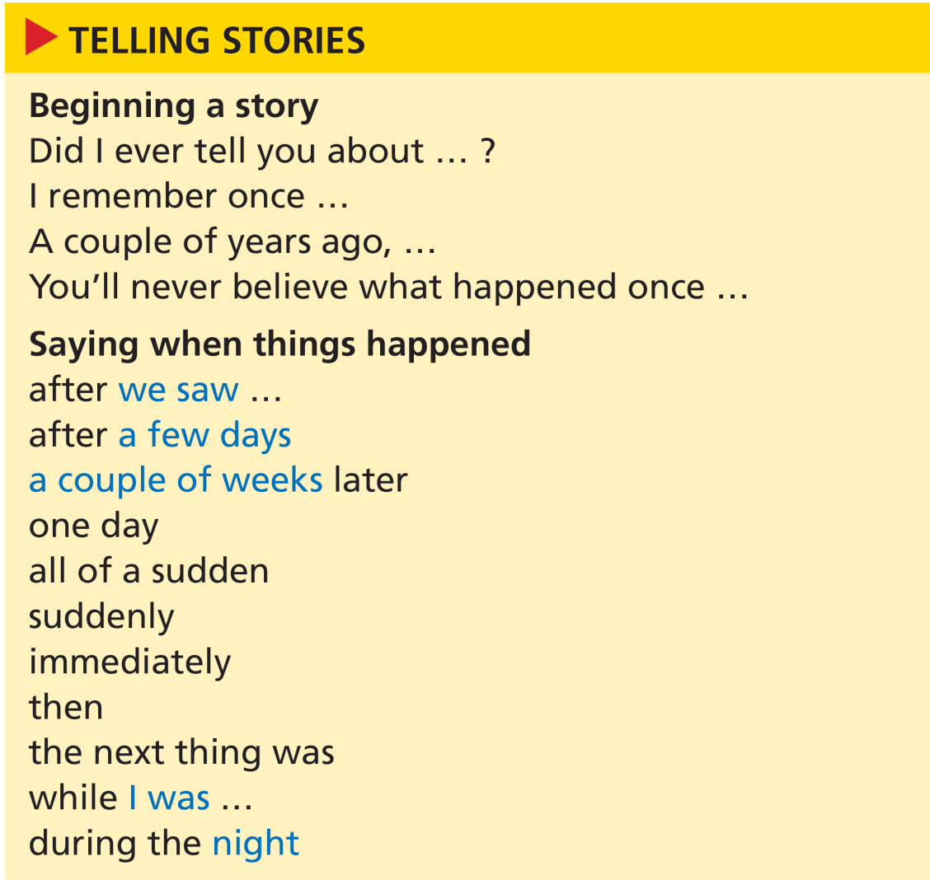
3 Listen to two stories. Which story matches the photo? What would a photo of the other story show?
Track 25
Story 2
A photo for Story 1 might show two fish splashing in some water in a sink.
4 Look at the expressions for telling stories. Listen to the stories again. Tick the expressions the speakers use.
Track 25
Students should tick all the expressions except:
You’ll never believe what happened once …
while I was …
3d-p. 40

Slide 55
Script
Track 25
1
A: Did I ever tell you about the time my goldfish learned to fly?
B: What? No, I don’t think so.
A: Well, we had these two goldfish. They were really huge. And they lived in a fish tank above the kitchen sink. But these two fish were really active. They loved to jump in the air. Especially when someone was doing the dishes.
B: No way!
A: Seriously! After we saw it the first time, we put a lid across the top of the tank. So, a couple of weeks later, I came into the kitchen one morning and the tank was empty.
B: Oh, no!
A: Oh, yes! During the night, the fish had jumped out of the tank! They were lying in the sink! Fortunately, there was some water in it!
B: That’s incredible!

Slide 56
Script
Track 25
2
C: I remember once, a couple of years ago, we were looking after this friend’s parrot when he was on a business trip. Anyway, after a few days, I realized that this parrot knew how to open its cage.
D: Really?
C: Oh yes! It happened a couple of times. When I went out, the parrot was in its cage. And when I got back home, it had got out. So one day, I was at work and all of a sudden I remembered that I hadn’t filled up the bird’s food and water. I immediately rushed back home … and there it was … the empty cage again. I searched everywhere. I was going round the house calling ‘Polly! Polly, come on Polly’. But I couldn’t find it.
D: What happened then?
C: Well, the next thing was, I started to panic. So I went into the kitchen to make the tea, and guess what? There was the bird. It was having a bath in my teacup!
D: That’s unbelievable!

Slide 57
5 Only one of the stories is true. Which one do you think it is?
The first story is true. It happened to the author. The lid partially covered the tank but they had knocked it off anyway. Both fish survived and were lucky not to have been eaten by the family cat!
6 Pronunciation was and were
a Listen to the sentences from the stories in Exercise 3. Notice the sound /ə/ in was and were.
Track 26
b Listen again and repeat the sentences. Pay attention to how you say was and were.
Track 26
3d-p. 40

Slide 58
Script
Track 26
1 Especially when someone was doing the dishes.
2 They were lying in the sink!
3 we were looking after this friend’s parrot
4 I was going round the house calling ‘Polly’!

Slide 59
7 Work in pairs. Choose one of the stories from Exercise 3. Take a role each. Look at the audioscript on page 181 and prepare your role. Then close your books and practise the conversation. Change roles and repeat with the other story.
8 Work in pairs.
Student A: Tell your partner about three surprising or embarrassing things that happened to you or to someone you know. One of the things should be untrue. Use the expressions for telling stories to help you.
Student B: Try to guess which of your partner’s stories is untrue.
A: Did I ever tell you about the time I found some money?
B: No, you didn’t.
3d-p. 40

Slide 60
3e What a weekend!
Writing a blog post
1 Do you read or write any blogs? What kind of things do people write about in personal blogs? And in professional blogs?
EXAMPLE ANSWERS
Personal blogs: what they’ve been doing, photos, thoughts and feelings, interests, travel, personal opinions
Professional blogs: advice and tips, information about a company or product, feedback on meetings or conferences
3e-p. 41

Slide 61
2 Read the post and answer the questions.
1 What is the topic of this post?
2 What do you think beach gear refers to?
3 Who do you think Ellie, Louis and Oscar are?
1 It’s about an unusual experience on the beach that the writer and his family had last weekend. (They saw people who were picking up Nike trainers that had washed up on the beach.)
2 The things you take to the beach: towels, swimming costumes, sunglasses, sunhats, etc.
3 Ellie, Louis and Oscar are the blogger’s three children.
3e-p. 41

Slide 62
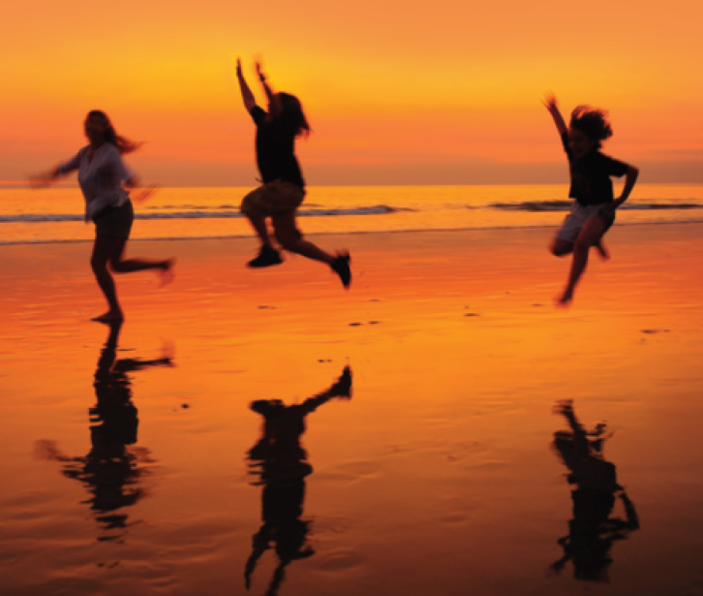
The calm after the storm
It was pouring with rain all weekend,so we spent almost the whole time indoors trying to entertain the kids. Then, unexpectedly, the sun came out late on Sunday afternoon. We grabbed our beach gear, jumped into the car and headed down to the bay. When we got there, we realized that everyone had had the same idea! The beach was packed. But everyone was staring out to sea and picking stuff up off the sand. Ellie, Louis and Oscar rushed down to the water’s edge, full of excitement. It turned out that a ship had lost its cargo in Saturday’s storm. Five containers of Nike trainers had washed up on the beach! Everyone was clutching odd shoes, looking for the other one to make a pair! What a strange end to the weekend!
Written by James 28 Feb 23.17
See older posts
3e-p. 41

Slide 63
3 Put the main events of the story (a–g) in the correct order.
a Ellie, Louis and Oscar ran to the sea.
b The sun started to shine.
c There was a storm.
d A ship lost a cargo of trainers.
e They got into the car.
f They picked up things to take to the beach.
g They went to the beach.
6
2
1
7
4
3
5
3e-p. 41

Slide 64
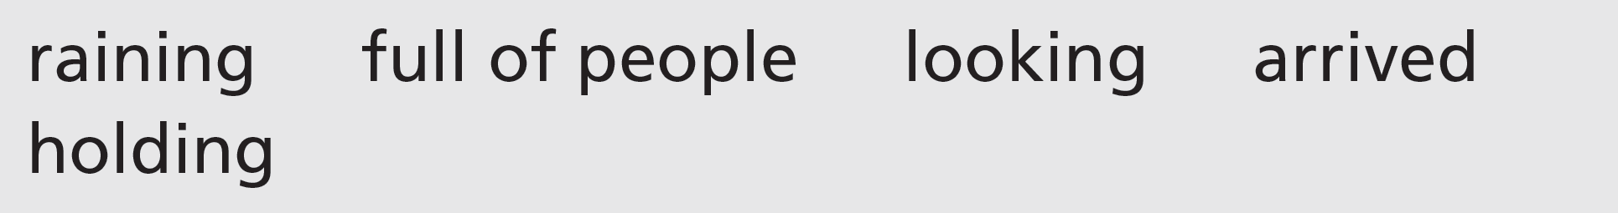
4 Writing skill interesting language
a Compare the post with the sentences in Exercise 3. Which verbs does James use instead of the verbs in bold? Why?
a ran = rushed
b started to shine = came out
e got = jumped
f picked up = grabbed
g went = headed
b Circle the verbs and adjectives that James uses instead of these words.
raining = pouring with rain
full of people = packed
looking = staring
arrived = washed up
holding = clutching
3e-p. 41

Slide 65
c Read the sentences. Replace the words in bold with these words.
1 The kids raced along the street.
2 I felt exhausted after my walk.
3 The weather was boiling hot.
4 We crawled up the river bank with difficulty.
5 I wandered along the beach, enjoying the silence.
6 At the end of the game, we collapsed on the sand.
ran
tired
really
got
walked
fell down
3e-p. 41

Slide 66
5 Think about a recent weekend or one where something unusual happened. Make notes of the main events in your weekend. Then add notes with background information.
6 Write a first draft of a blog post or other social media post about your weekend. Then look at the vocabulary you have used. Try to use interesting language in your post.
7 Use these questions to check your post.
• Have you used different past verb forms correctly?
• Have you used interesting vocabulary to tell the story?
8 Work in pairs. Exchange posts. Can you suggest two more verbs or adjectives that your partner could use?
3e-p. 41

Slide 67
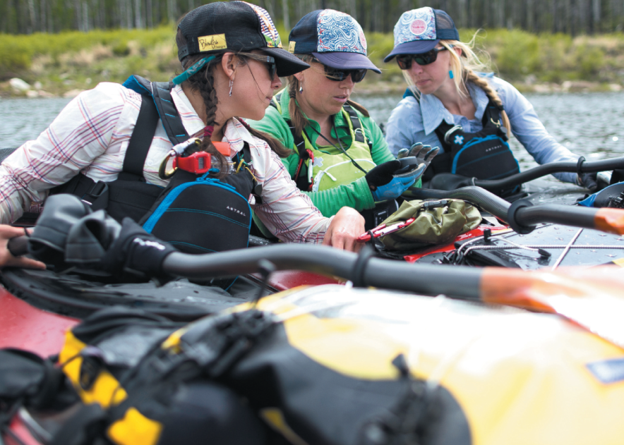
3f Four women and a wild river
Before you watch
Amber Valenti and some of her team on their trip down the Amur River
1 Work in pairs. Look at the photo and the caption. Then read the information. Would you like to do this kind of trip? Why? / Why not?
Amber Valenti was the leader of a kayak trip
down the Amur River in Mongolia, Russia
and China. The river is one of few major
rivers that flow from their start to the sea
without dams or reservoirs. The Amur River begins in Mongolia and part of its 2,800 kilometres marks the border between Russia and China. The trip took two months to complete.
See next slide for answers
3f-p. 43

Slide 68
Exercise 1
EXAMPLE ANSWERS
Possible reasons for doing the trip: exciting, challenging, seeing the world, having an adventure, learning new skills, learning about new cultures
Possible reasons for not doing it: dangerous, long time away from home, difficult conditions to live in, need to be adventurous and strong and athletic

Slide 69
2 Key vocabulary
a Read the sentences. The words in bold are used in the video. Guess the meaning of the words.
1 The concept of the new TV show is to explain how everyday objects work.
2 We’ve found a sponsor to give us most of the money we need for our expedition.
3 The most memorable holiday I’ve ever had was in China.
4 I’m passionate about my hobby playing drums in a band.
5 Conservation is a big part of the work of the World Wildlife Fund.
6 The most enjoyable aspect of my job is meeting new people.
3f-p. 43

Slide 70
b Match the words in bold in Exercise 2a with these definitions.
3
4
1
6
2
5
a difficult to forget
b having strong feelings about something
c idea
d one part of a problem or situation
e someone who supports people’s activities with money, equipment, etc.
f the protection of natural places, plants and animals
Concept
Sponsor
Memorable
Passionate
Conservation
Aspect
3f-p. 43

Slide 71

While you watch
3 Watch the whole video. Which of these words do you think describe the experience the women had? Give reasons for your answers.
All four words are possible depending on the students‘ opinion.
4 Watch the first part of the video (0.00–0.45) again. Complete the sentences with the information you hear.
1 Amber Valenti wanted to explore the Amur River and also to … .
2 The people she wanted to invite on the trip were … .
3 Having an all-woman trip was an advantage with … .
1 bring the story back to their communities
2 all women
3 sponsors
3f-p. 43

Slide 72
5 Watch the second part of the video (0.46 to the end) again. Answer the questions.
1 Amber Valenti describes moments of the trip as ‘joyful and light’ and ‘intense’. What scenes in the video show this?
2 What kind of things do you see when they reach the mouth of the river?
3 Why does Amber Valenti want people to fall in love with the ‘human aspect’ of the river?
1 joyful and light: getting into the kayak head first, dancing with the Mongolian men, chatting in their sleeping bags
intense: the thunderstorm
2 ships, cranes, industry
3 because she thinks it’s the best way for people to become conservationists
6 After watching the video, do you feel differently about your answer to Exercise 1?
3f-p. 43

Slide 73
Videoscript
Four women and a wild river
Part 1
0.00–0.23 Amber Valenti The concept of the Nobody’s River project was to travel and explore the Amur river, which is the third longest free-flowing river left on this awesome planet we live on. And what we wanted to do was both experience it ourselves and then also bring the story back to our community.
0.24–0.45 Well, it started out as the people I wanted to invite were all women. I love adventuring with boys too, but there is something really fun about ladies’ trips and so we thought, well, maybe we can tell this through a female perspective. And then as we were pursuing sponsors after that we realized what a huge advantage that was because people are hungry for that voice.
Part 2
0.46–1.01 The moments where we could just not take life or ourselves very seriously are really memorable for me.
1.02–1.24 It really was joyful and light frequently, though it was also very intense frequently as well.
1.25–1.53 I’m a very passionate conservationist. I am very passionate particularly about clean water and rivers. The best way to help people become conservationists is to help them fall in love with a place and so our goal with showcasing a river was to help them connect to the human aspect of it and then through that just let them fall in love with it all on their own.

Slide 74

After you watch
7 Vocabulary in context
a Watch the clips from the video. Choose the correct meaning of the words and phrases.
b Complete the sentences in your own words. Then work in pairs and compare your sentences.
1 I think learning English / windsurfing is awesome.
2 In my experience, travelling on your own / meeting new people is really fun.
1 I think … is awesome.
2 In my experience, … is really fun.
3 I can’t … all on my own.
4 People today are hungry for … .
5 I think that … take themselves very seriously.
3 I can’t organize everything / redecorate the house all on my own.
4 People today are hungry for a real connection with nature / new experiences.
5 I think that politicians / scientific experts take themselves very seriously.
3f-p. 43

Slide 75
Videoscript
Four women and a wild river
a
1 ... this awesome planet we live on.
a amazing
b enormous
c wild
2 ... there’s something really fun about ladies’ trips ...
a very different
b very enjoyable
c very strange
3 ... people are hungry for that voice.
a don’t know about
b need food
c want to hear
4 The moments when we could just not take life or ourselves very seriously ...
a deal with our problems
b take care of ourselves
c think we are important
5 ... let them fall in love with it all on their own.
a all at the same time
b when they were alone
c without help
b
c
c
c

Slide 76
8 The trip described in the video was filmed for a documentary called Nobody’s River. From what you have learned, why do you think the film-makers chose that title?
EXAMPLE ANSWER
The probable reason is because the river goes along the borders of countries so no one country can claim it. Also, no country has exploited the river by building dams or bridges.
3f-p. 43

Slide 77
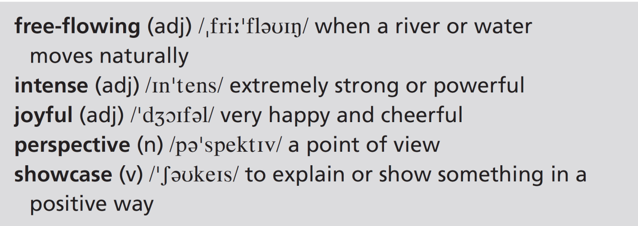
9 Imagine you are going to be away from home for two months. What would you take with you from home? What essential things would you take in each of these situations? Discuss your answers with the class.
1 You’re going on an expedition to a place similar to the video.
2 You’re going on a long holiday with your family or friends.
3 You’re a professional sportsperson and you’re going on a world trip.
EXAMPLE ANSWERS
1 Possibilities include: backpack, compass, map, mobile phone with battery recharge facilities, phrasebook, water purifying tablets, camping equipment, tent
2 Possibilities include: towel, sunglasses, bathing costume, camera, mobile phone, passport
3 Possibilities include: mobile phone, sports equipment, medicine
3f-p. 43

Slide 78
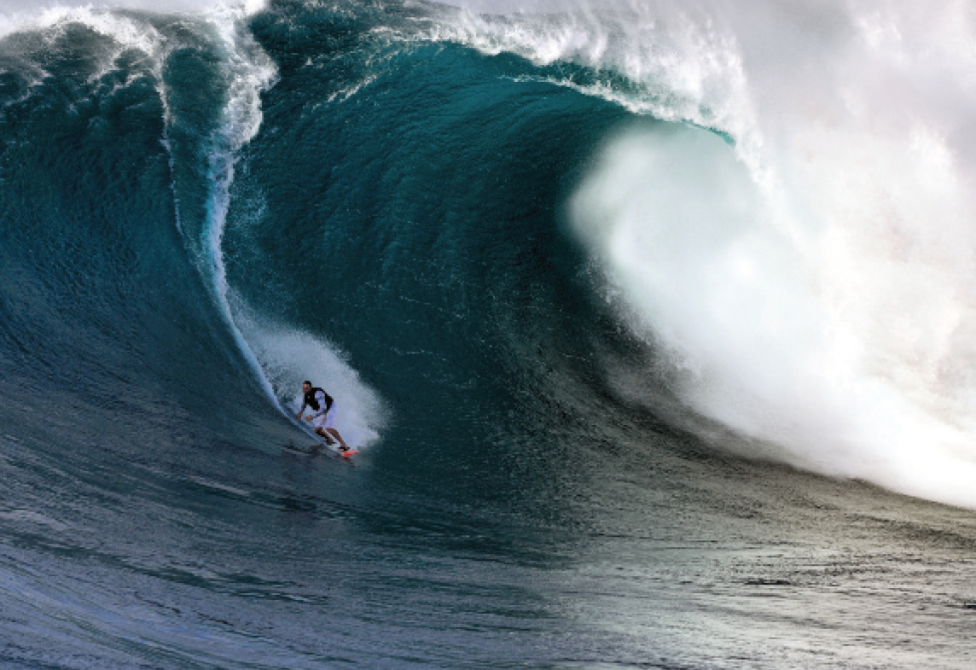
UNIT 3 REVIEW AND MEMORY BOOSTER
Grammar
1 Change the verbs in this story to the past continuous or past perfect simple where appropriate.
1, 2, 3, 5, 9, 10, 12, 13, 15 and 16 are correct.
‘I 1 learned to surf a few years ago when I 2 was in my teens. My dad 3 paid for a course, as a present, because I 4 just passed some important exams. It 5 was a sunny weekend in June. Anyway, the whole first day 6 went by and I 7 didn’t manage one successful ride. All my friends 8 watched and of course I 9 wanted to impress them. I eventually 10 paddled out for my last attempt of the day when the sun 11 set over the bay. I 12 scrambled onto the board and for the first time I 13 didn’t fall off straightaway. I 14 just got up on my feet on the board when someone almost 15 crashed right into me! But I
16 stayed on!’
4 had just passed 6 had gone by 7 hadn’t managed
8 were watching 11 was setting 14 had just got up
U3 Review-p. 44

Slide 79

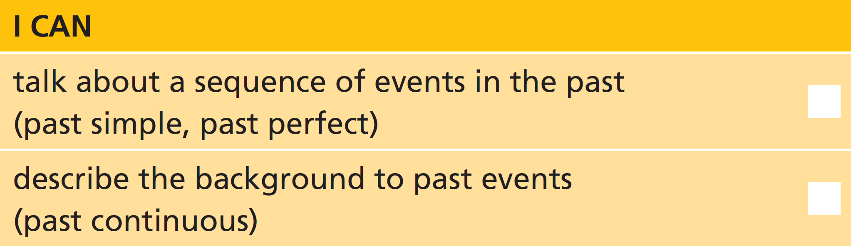
2 Answer the questions about the story in Exercise 1.
1 What was the speaker’s reason for learning to surf?
2 Why was the speaker so happy when he/she didn’t fall off the board?
1 His/Her dad paid for a course, as a present, because he/ she had just passed some exams.
2 Because the whole first day he/she hadn’t managed one successful ride.
3 Try to remember the main events from the story in Exercise 1. Make notes using single words. Then work in pairs. Exchange your notes with your partner. Retell the story using your partner’s notes.
U3 Review-p. 44

Slide 80
Vocabulary
4 Match the adverbs (1–6) with the phrases (a–f). Then write six sentences.
b
c
a
e
f
d
1 badly
2 calmly
3 carefully
4 politely
5 secretly
6 suddenly
a check exam answers
b drive a car
c sit in a dentist’s chair
d have a brilliant idea
e talk to a stranger
f organize a party
Example sentences:
I don’t drive a car badly.
I try to sit calmly in the dentist’s chair.
My brother never checks his exam answers carefully!
It’s important to talk politely to strangers.
I’m going to secretly organize a party for my parents’ wedding anniversary.
I’ve suddenly had a brilliant idea!
U3 Review-p. 44

Slide 81
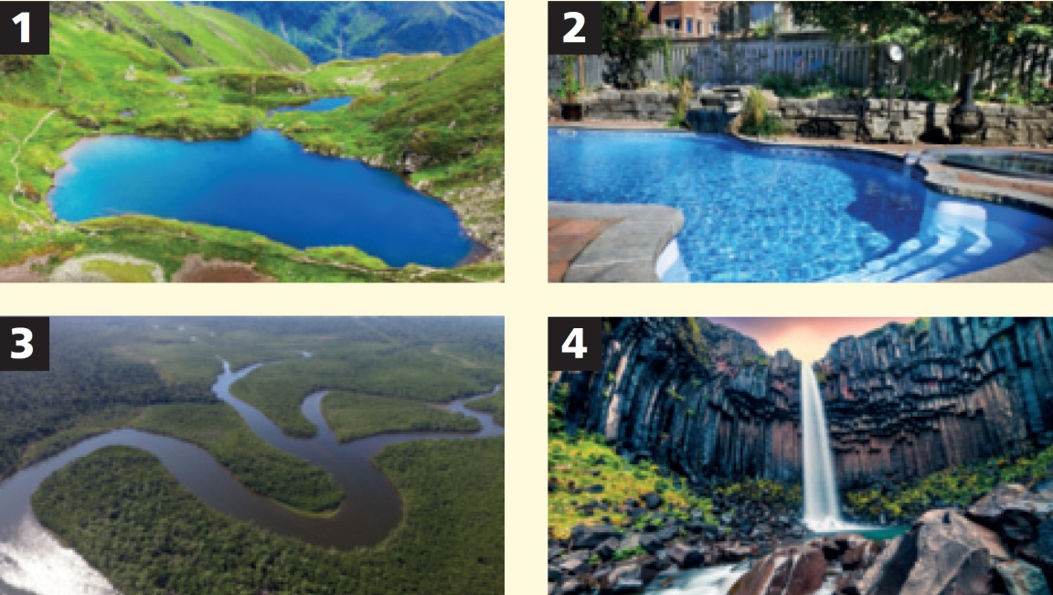
5 Work in pairs. What are these places? Can you think of two more places with water? How many examples of each place can you name?
1 lake
2 swimming pool
3 river
4 waterfall
Also, for example: ocean, sea, stream, reservoir, pond, canal
Students’ own answers for examples of names for each one.
U3 Review-p. 44

Slide 82
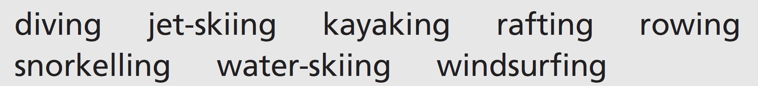
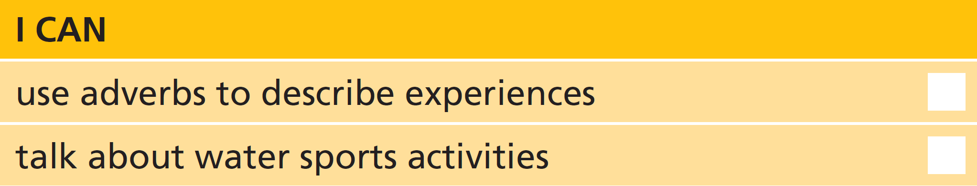
6 Work on your own. Choose the two activities you think best match each category (1–4). Then work in pairs. Explain your reasons.
1 people find this relaxing
2 people do this to get a thrill
3 it’s best to do this with other people
4 people do this at weekends
Students’ own answers – it can vary greatly depending on
each person’s point of view.
U3 Review-p. 44

Slide 83
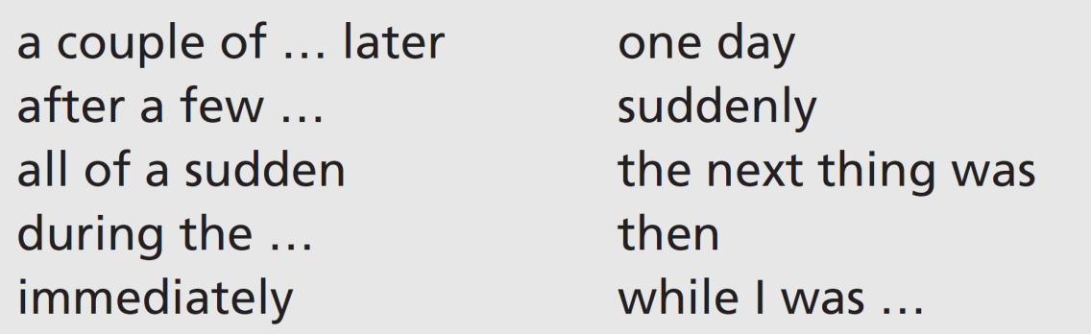
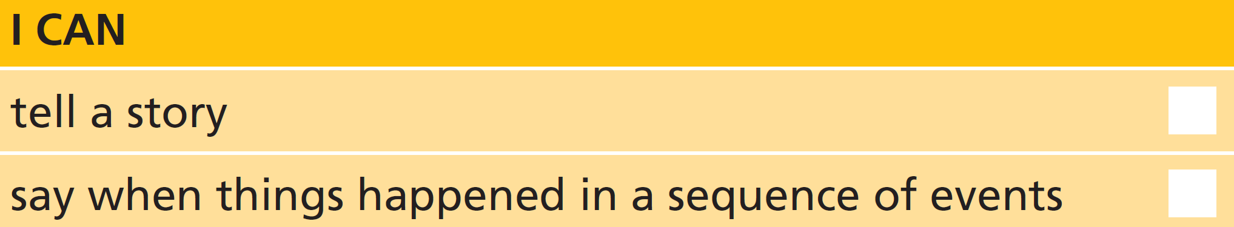
Real life
7 Work in groups. Tell a story starting with this sentence. Take turns to add a sentence to the story, using one of these expressions.
‘Did I ever tell you about the time my cat ate my homework?’
8 Use one of these first sentences and tell another story.
‘I remember once, I was waiting at the bus stop.’
‘A couple of years ago, I went for a job interview.’
‘You’ll never believe what happened once when I was doing an exam.’
U3 Review-p. 44

Slide 84
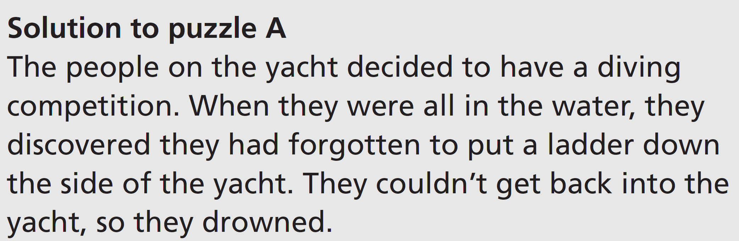
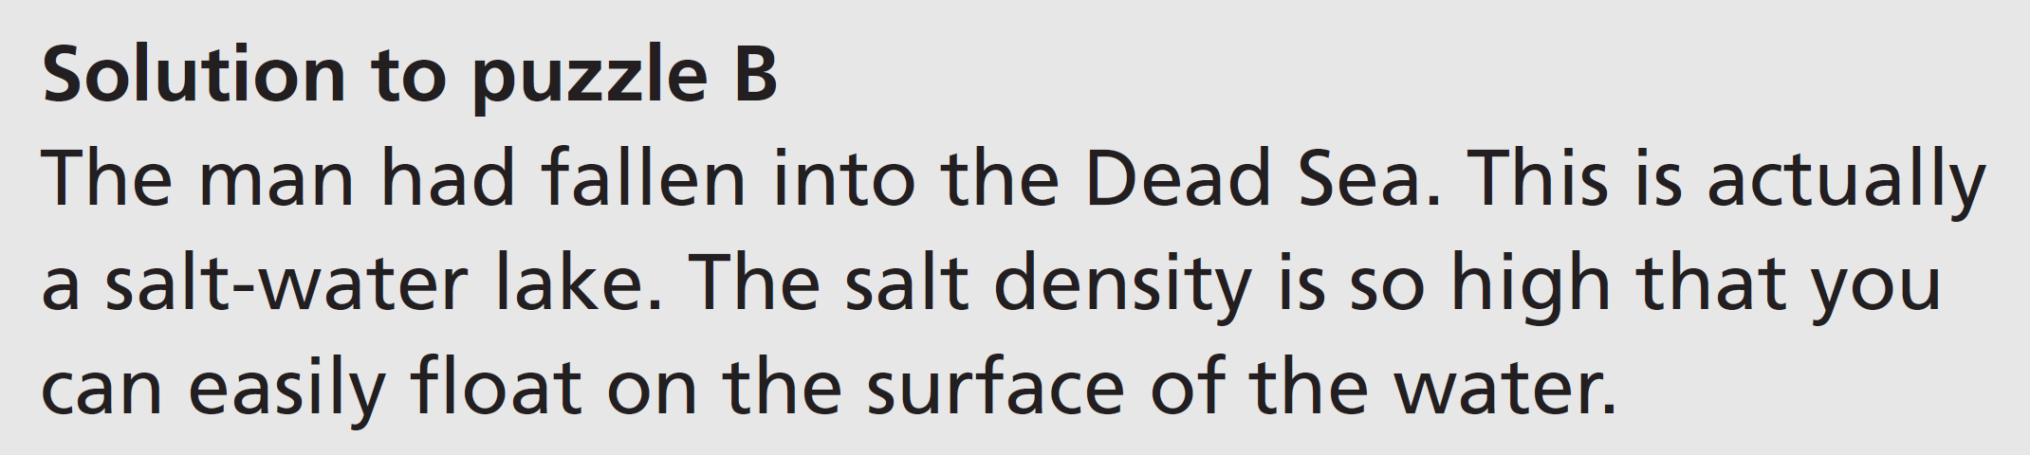
Communication activities
Unit 3b Exercise 10, page 37
Pair A
Read the solution to puzzle A. Pair B will ask you questions to discover the answer to this puzzle. Then ask Pair B questions to discover the answer to puzzle B. Then turn back to page 37.
Pair B
Ask Pair A questions to discover the answer to puzzle A. Then read the solution to puzzle B. Pair A will ask you questions to discover the answer to this puzzle.
p. 153, p. 154

